Slide 1
ReconcileX - AI Agent powered Reconciliation System🚀
Problem Statement - Smarter Reconciliation and Anomaly Detection using Gen AI
Team- Hack GPT
Praveen Kumar
Shubham Prabhu
Kirthi Govindarajan
Zaid Ali Syed

Slide 2
Key Areas Of Improvement🚀
Manual-Intensive & Inefficient: Traditional reconciliation processes rely on rigid rules and manual effort, struggling to scale with dynamic, high-volume transactions.
Limited Fraud Detection: Static anomaly detection methods fail to capture evolving fraud patterns and operational inconsistencies.
High-Stakes Risks: Inefficiencies can lead to financial losses, compliance violations, and reputational damage for a global bank like Wells Fargo.
Need for AI-Driven Solutions: Generative AI can enable smarter, automated, and adaptive reconciliation with enhanced anomaly detection.

Slide 3
Proposed Solution🚀
Automated Break Resolution: Utilize LLMs (Llama/Mistral) to automatically propose fixes for reconciliation discrepancies.
Real-Time Anomaly Detection: Employ LSTM, and Isolation Forest to instantly flag anomalies with detailed LLM-generated summaries.
Human-in-the-Loop Validation: Enable operators to approve or reject AI-suggested fixes, with feedback loops refining accuracy.
Simulated External Integration: Scalably integrate with systems like JIRA, email, and trade platforms using LangChain for automating the fix.
Interactive Dashboard: Offer a user-friendly interface for reviewing anomalies, diagnosing root causes, and implementing fixes seamlessly.

Slide 4
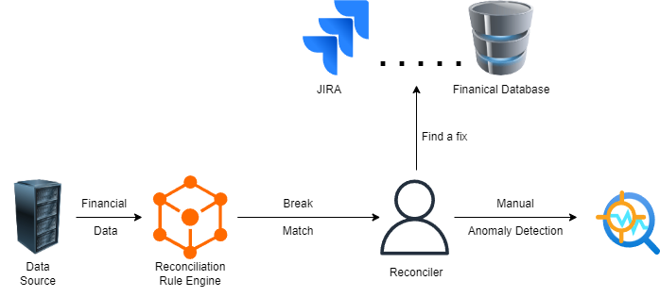
Current Reconciliation Architecture

Slide 5
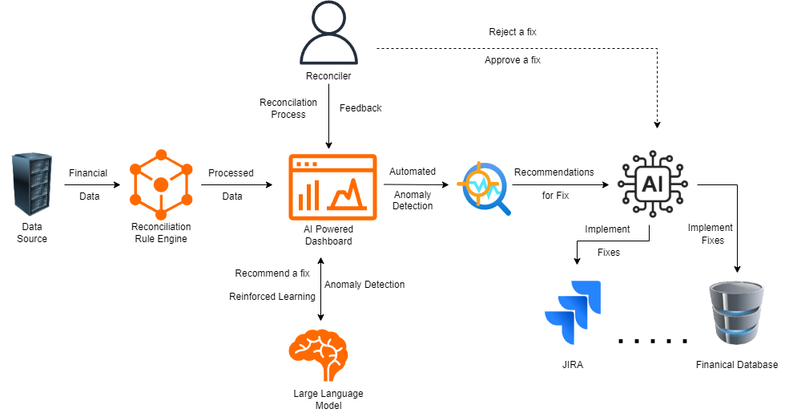
Proposed Reconciliation Architecture

Slide 6
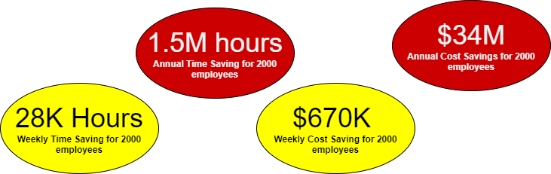
Business Impact
*Time and cost savings are calculated considering 2000 reconciler employees

Slide 7
Thank You

Slide 8
Appendix
Time Savings Calculation per Employee:
Manual Reconciliation Time: Assuming employees spend 20 hours per week on reconciliation tasks.​
Time Saved with AI Automation: 70% of 20 hours = 14 hours per week.​
Annual Time Savings for 2,000 Employees:
Weekly Time Savings per Employee: 14 hours.​
Total Weekly Time Savings: 14 hours/employee × 2,000 employees = 28,000 hours.​
Annual Time Savings: 28,000 hours/week × 52 weeks = 1,456,000 hours.​
Cost Savings Calculation:
Average Hourly Wage: Assuming an average wage of $24 per hour.​
Annual Cost Savings: 1,456,000 hours × $24/hour = $34,944,000.

